Slide 1
Neon NTT: Faster Dilithium, Kyber, and Saber on Cortex-A72 and Apple M1
Hanno Becker, Vincent Hwang, Matthias J. Kannwischer
Bo-Yin Yang, Shang-Yi Yang
CHES 2022

Slide 2
Agenda
Connecting Montgomery and Barrett reduction
Barrett multiplication
AArch64 Neon implementation
Results & Outlook

Slide 3
Some observations on modular arithmetic

Slide 4
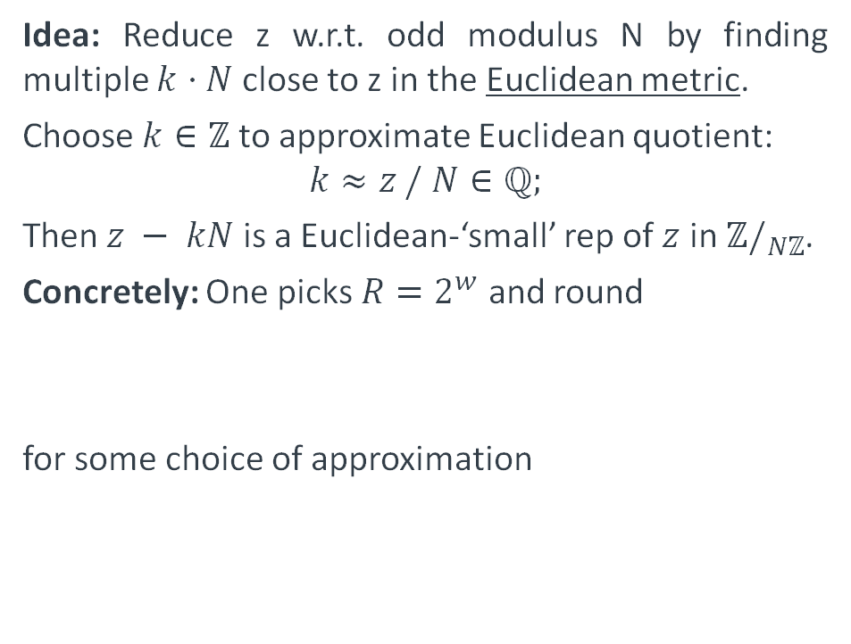
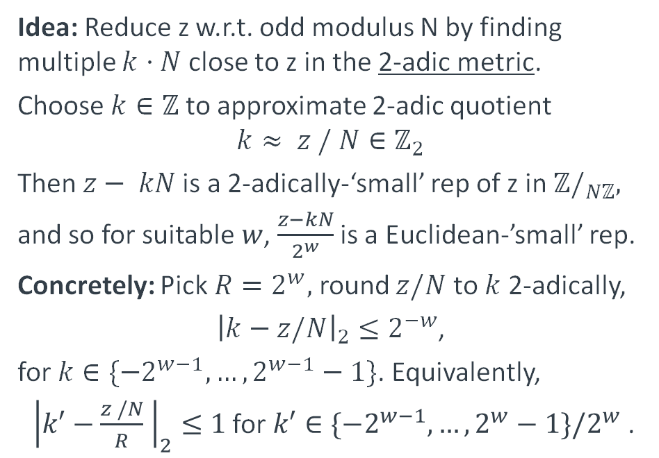
Barrett Reduction and Montgomery Reduction
Recalling the ideas
Barrett reduction
Montgomery reduction
Idea: Reduce z w.r.t. odd modulus N by finding multiple $k⋅N$ close to z in the Euclidean metric.
Choose $k∈ℤ$ to approximate Euclidean quotient:
$$k≈z / N∈ℚ;$$
Then $z − kN$ is a Euclidean-‘small’ rep of $z$ in $ℤ/_{Nℤ}$.
Concretely: One picks $R=2^{w}$ and round
for some choice of approximation
Idea: Reduce z w.r.t. odd modulus N by finding multiple $k⋅N$ close to z in the 2-adic metric.
Choose $k∈ℤ$ to approximate 2-adic quotient
$$k≈ z / N∈ℤ_{2}$$
Then$z− kN$ is a 2-adically-‘small’ rep of z in $ℤ/_{Nℤ},$
and so for suitable $w$, $\frac{z−kN}{2^{w}}$ is a Euclidean-’small’ rep.
Concretely: Pick $R=2^{w},$round $z/N$ to $k$ 2-adically,
${\left|k−z/N\right|}_{2}≤2^{−w}$,
for $k∈\{−2^{w−1},…, 2^{w−1}−1\}$. Equivalently,
${\left|k′−\frac{z /N}{R} \right|}_{2}≤1$for $k′∈\{−2^{w−1},…,2^{w}−1\}/2^{w}$ .

Slide 5
Barrett Reduction and Montgomery Reduction
Both based on rounding
Generalities on rounding
Connecting Barrett and Montgomery
Barrett and Montgomery both rely on rounding:
Expressing a noncompact ’continuum’ as the sum of a discrete set and a relatively compact set of small elements.
Barrett reduction uses rounding of rationals
Montgomery uses rounding of 2-adic numbers
It becomes clear that 2-adic and Euclidean rounding are two views of the same decomposition: For
Considering the descriptions of Barrett and Montgomery reduction as
this suggests a relation between them… and indeed:

Slide 6
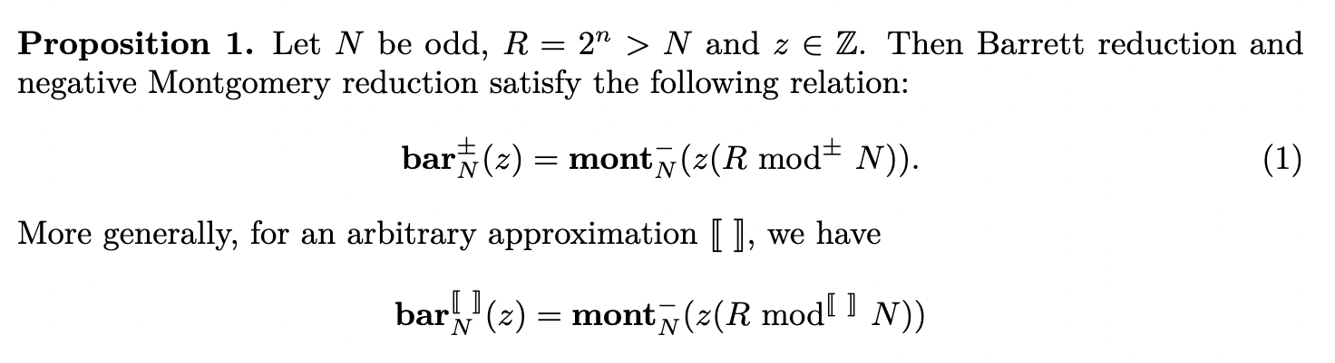
Barrett Reduction and Montgomery Reduction
Are essentially the same
Here,
is the canonical representative w.r.t. the chosen approximation.
generalizing the known
This is useful e.g. for transferring bounds on Montgomery reduction to Barrett reduction.
It also begs the question of what the analogue is for Montgomery multiplication.

Slide 7
Generalizing to Barrett multiplication
Question: What’s the analogue of Montgomery multiplication on the Barrett side?
Answer: “Barrett multiplication”
[Note: We learned after the publication that the unsigned version of Barrett multiplication had already been described by Victor Shoup, and is sometimes called “Shoup multiplication”]
Idea: Generalize approximation in Barrett reduction,
to
Then Barrett and Montgomery multiplication are related as before.
However: Barrett multiplication only works for modular multiplications with constants!

Slide 8
AArch64 Neon Implementation

Slide 9
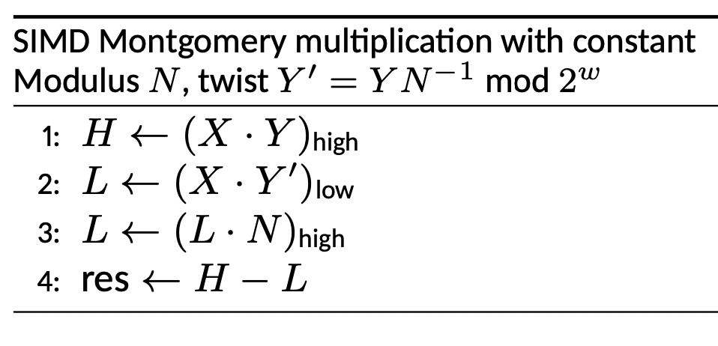
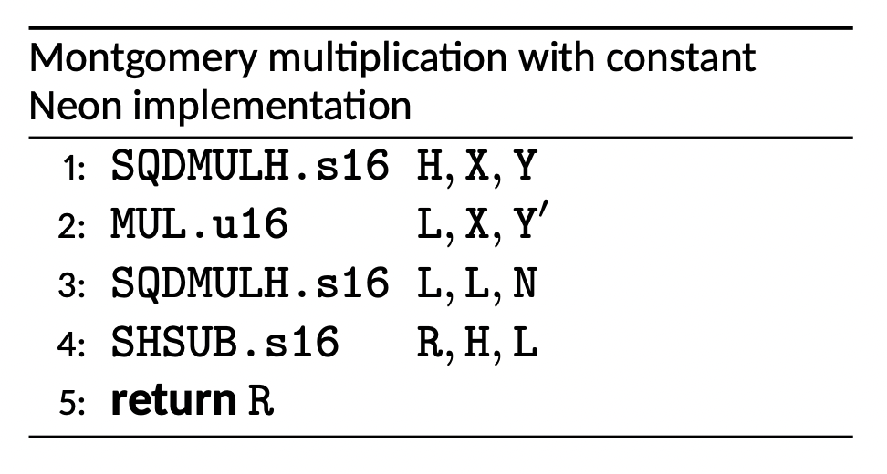
Single-width modular arithmetic
Assembly implementations
Montgomery multiplication
Montgomery multiplication with constant can be done [1] using 2x high-mul, 1x low-mul, 1x sub.
No double-width products – suits SIMD
No high-multiply in Neon; use doubling multiply SQDMULH & halving subtract SHSUB instead.
(Armv8.4-A) SQRDMLAH allows eliminating SHSUB (cf. “Polynomial Multiplication on Embedded Vector Architectures” talk)
[1]: Seiler, “Faster AVX2 optimized NTT multiplication for Ring-LWE lattice cryptography”

Slide 10
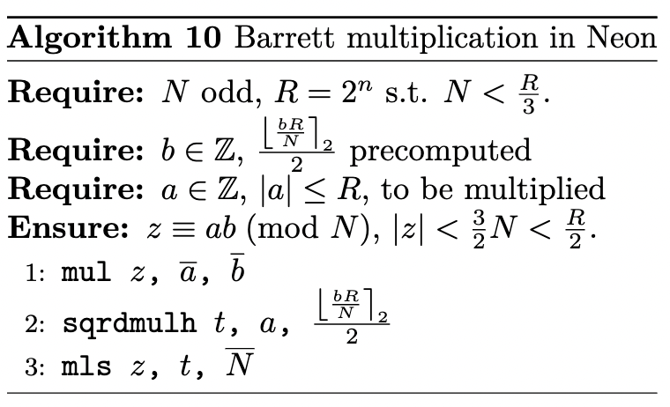
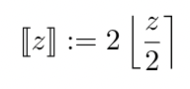
Single-width modular arithmetic
Assembly implementations
Barrett multiplication
Barrett multiplication has a ‘dual’ instruction profile compared to Montgomery multiplication
2x low-mul, 1x high-mul with rounding, 1x sub
Better than Montgomery multiplication:
Can combine MUL+SUB into MLS
(No funny parity hacks needed)
MUL => MLA often has 1-cycle forwarding paths (see Software Optimization Guides)
Problem: Compensate doubling in SQRDMULH?
Solution: Use flexibility in the choice of integer approximation: Pick even-valued

Slide 11
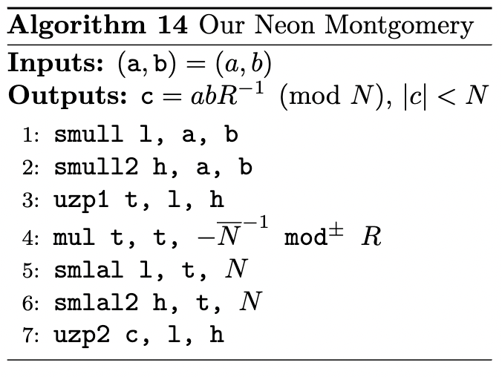
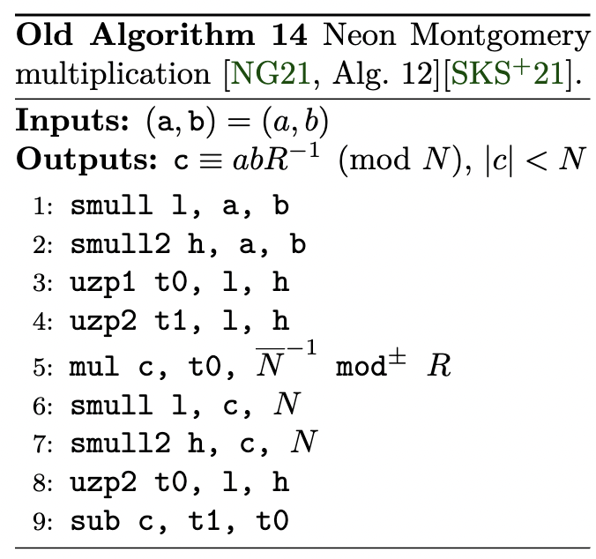
Double-with Montgomery multiplications
Assembly implementations
Better accumulation for base multiplication
When accumulating modular products, it’s better to accumulate in double-width and reduce lazily.
We find a shorter & faster code for double-width Montgomery multiplication compared to prior art

Slide 12
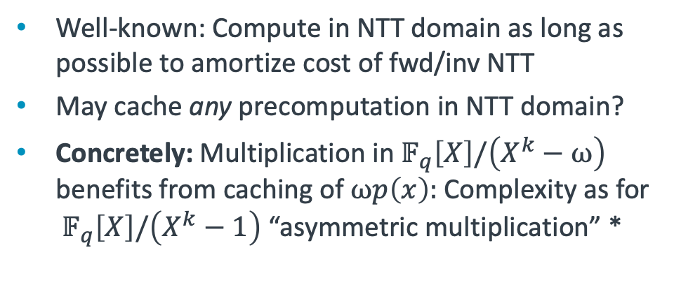
Kyber, Dilithium, Saber
Neon implementations
Number Theoretic Transform (NTT)
Asymmetric Multiplication
AArch64 Neon NTTs + base multiplications for
Kyber (16-bit, 7-level incomplete, 4+3)
Dilithium (32-bit, 8-level complete, 4+4),
Saber (32-bit, 6-level incomplete, 3+3)
Barrett multiplication for modular multiplications with twiddle factors
Double-width Montgomery multiplication with lazy reduction for base multiplication
The intra-vector shuffling required for the last layers is done via ld4/st4 or trn{1,2}
Well-known: Compute in NTT domain as long as possible to amortize cost of fwd/inv NTT
May cache any precomputation in NTT domain?
Concretely: Multiplication in${ 𝔽}_{q}\left[X\right]/\left(X^{k}−ω\right)$ benefits from caching of $ωp\left(x\right):$Complexity as for ${ 𝔽}_{q}\left[X\right]/\left(X^{k}−1\right)$ “asymmetric multiplication” *
Butterfly scheduling
Schedule butterflies based on which coefficients are needed first in the next layer to avoid stalls *
* Find further information and generalizations in Vincent Hwang’s thesis

Slide 13
Results

Slide 14
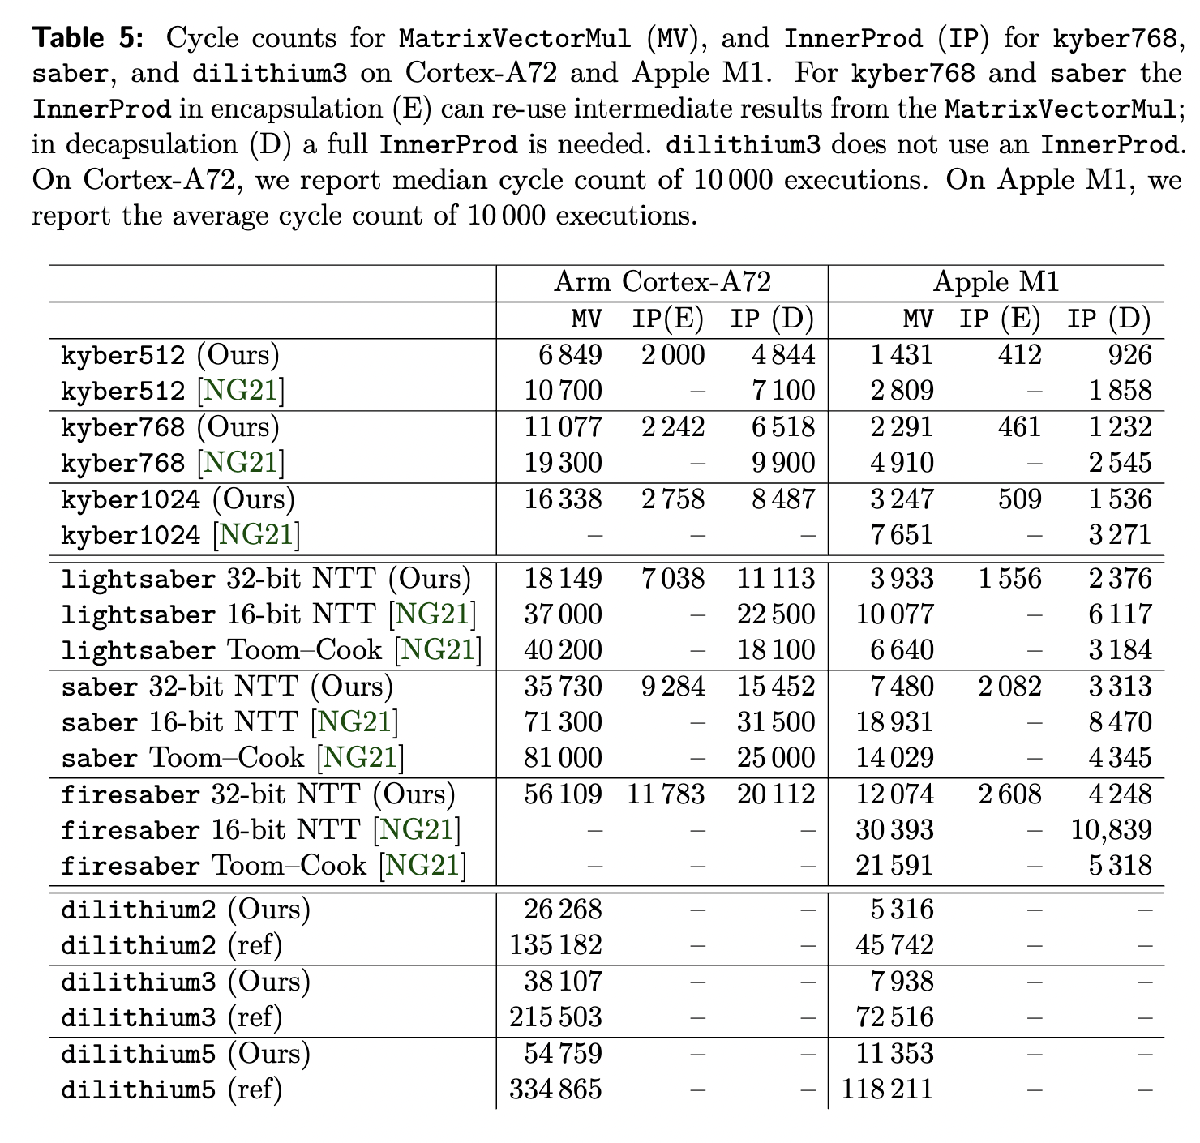
Performance results
Polynomial multiplication
Benchmarking environment
We benchmark on Cortex-A72 and Apple M1.
We use the Neon-based Kyber and Saber code from [NG21] and [SKS+21] as baseline
For Dilithium, use C code as baseline
Polynomial arithmetic performance
Cortex-A72: Speedups from 1.5x-2x
Apple M1: 2x-2.6x for NTT-based impl’n
MULx has throughput ½ on Cortex-A72, MULL(2) has throughput 1. Barrett mul is more impactful if MUL & MULL have same throughput.
Unsurprisingly, large speedup for Dilithium compared to reference C code

Slide 15
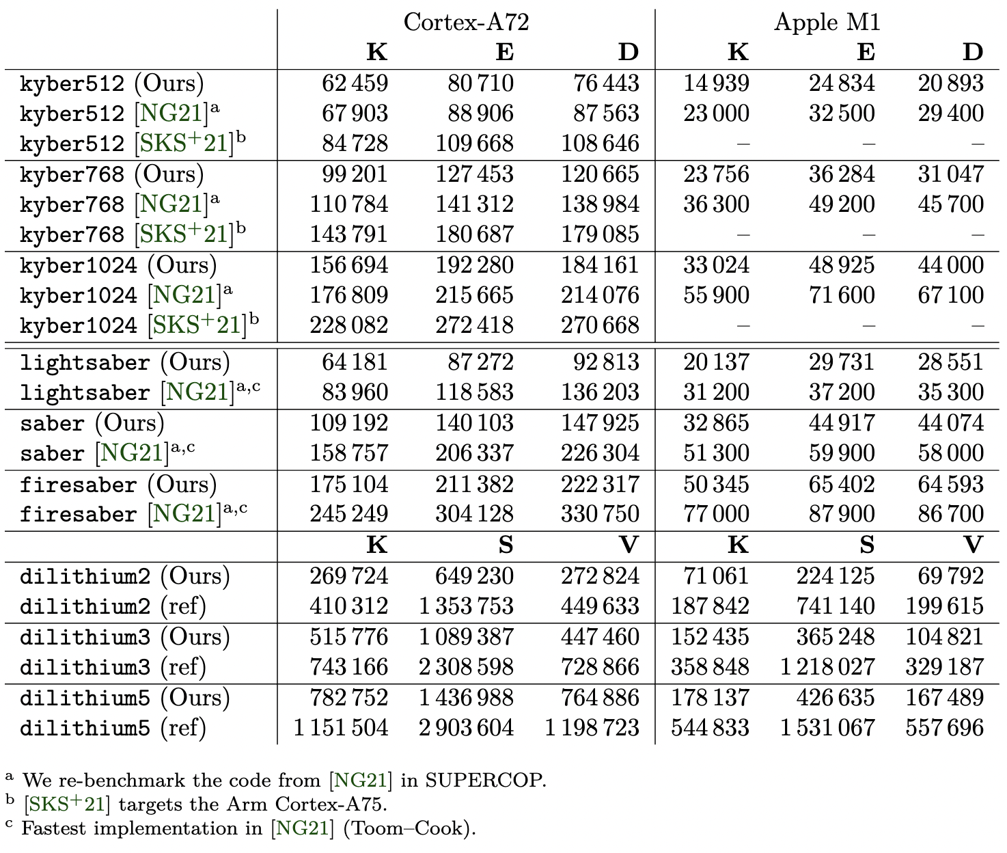
Performance results
Kyber, Dilithium, Saber
9%—35% improvements on Cortex-A72
24%-41% improvements on Apple M1
Polynomial arithmetic speedups watered down by dominance of SHA-3 which we did not optimize here (separate work)

Slide 16
Summary
Found relation between Montgomery and Barrett reduction
Extended to Barrett Multiplication, a new primitive for signed modular multiplications with constants with multiple benefits over Montgomery multiplication
Implemented and improved single width modular arithmetic in AArch64 Neon
Extended to optimized NTT-based implementations for Kyber, Saber, and Dilithium, significantly faster than previous implementations
Avenues for future work:
(in progress) Study NTT on other microarchitectures, e.g. Cortex-A510/A710/X2 generation. Faster multipliers should lead to larger impact of Barrett multiplication
(submitted) Study and improve SHA-3 performance on AArch64

